Slide 1


Department of Computer Science and Engineering
ELECTRICITY USAGE AND BILL PREDICTION SYSTEM
BASED ON HOUSEHOLD ATTRIBUTES
AND APPLIANCE CONSUMPTION
Mrs. M. Divya M.E.
Project Mentor
220701184
NEELA A

Slide 2
Problem Statement and Motivation
Problem Statement: The project focuses on predicting future energy consumption and electricity bills for households using machine learning. By analyzing historical data along with factors like house size, number of occupants, weather conditions, and heavy appliance usage, the system aims to forecast energy usage and costs, enabling users to manage their energy consumption effectively.
Motivation: With the rising cost of energy and increasing awareness of environmental impacts, efficient energy management has become a priority for households. This project provides users with valuable insights into their energy consumption patterns, offering practical recommendations and helping them reduce both energy usage and electricity bills.

Slide 3
Existing System
Currently, many household energy management solutions provide basic usage data but lack predictive capabilities. Existing systems often focus on real-time monitoring or historical analysis, without offering personalized insights or actionable recommendations for energy optimization. These solutions do not integrate factors such as weather conditions or appliance usage patterns to predict future consumption and bills, making them less effective for long-term energy management.
Schneider Electric’s Wiser Energy, Sense Energy Monitor, Enel X (formerly EnergyHub), Ecoisme

Slide 4
Objectives
Predict Future Energy Consumption and Bill
Provide Personalized Recommendations
Enhance Energy Efficiency
Track and Compare Energy Usage Over Time
Offer Targeted Consumption Goals
Integrate Multiple Models for Accuracy
Provide Insights into Appliance Usage

Slide 5
Abstract
In the face of rising energy costs and the growing need for sustainable practices, this project focuses on the development of an Energy Consumption Prediction and Optimization System aimed at providing users with insightful predictions and recommendations to manage their energy usage more effectively. By leveraging historical data such as past energy consumption, bills, household size, appliance usage, and weather conditions, the system employs advanced machine learning techniques, including Random Forest, Gradient Boosting, and Linear Regression models, to predict future energy consumption and associated bills.
In addition to predictive modeling, the system offers personalized energy-saving recommendations based on users' unique usage patterns. It provides actionable insights on improving energy efficiency, setting consumption targets, and optimizing the use of heavy appliances. The integration of these predictive models with real-time data processing allows for dynamic adjustments to energy consumption strategies, enabling users to make informed decisions that lead to cost savings and reduced environmental impact. This system aims to empower users with the knowledge to reduce their carbon footprint while managing energy costs effectively.

Slide 6
Proposed System
The proposed system leverages machine learning models to predict future energy consumption and bills based on past usage, household size, number of people, appliance usage, and weather conditions. It provides users with energy efficiency scores, personalized recommendations, and insights to optimize energy consumption, such as reducing appliance use during peak hours or using energy-efficient devices. The system also includes a web interface for easy data input and real-time feedback, helping users better manage their energy consumption and reduce bills while promoting sustainability.

Slide 7
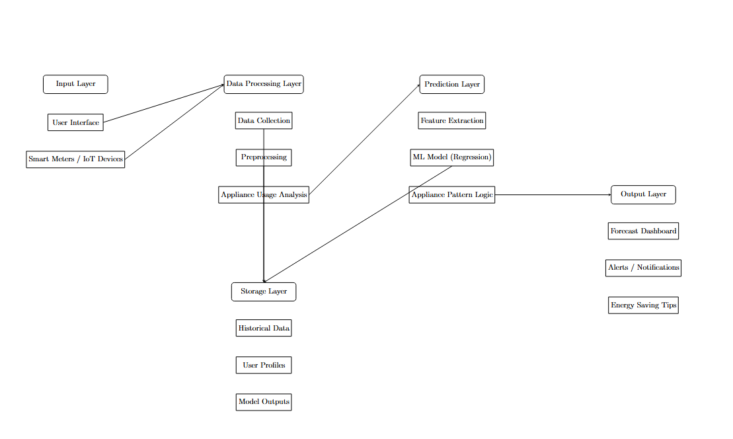
System Architecture

Slide 8
List of Modules
Data Preprocessing Module
Model Training Module
Prediction Module
Recommendation Engine Module
Efficiency Calculation Module
Model Storage Module
Data Encoding Module

Slide 9
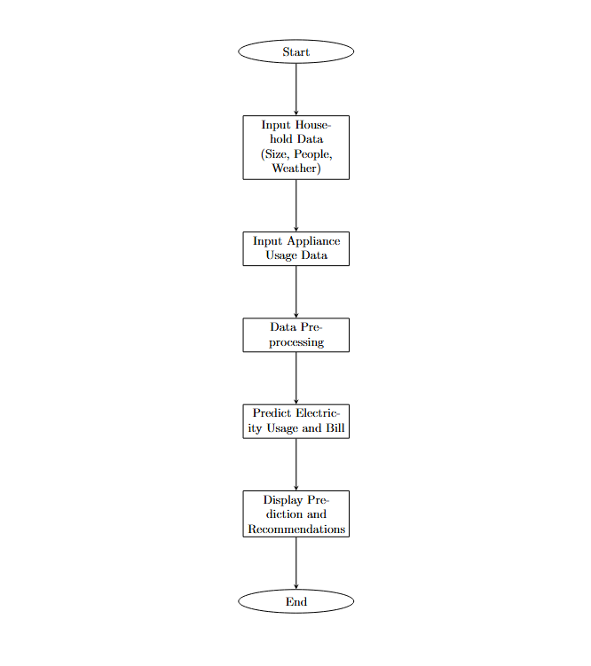
Functional Description for each modules with DFD and Activity Diagram

Slide 10
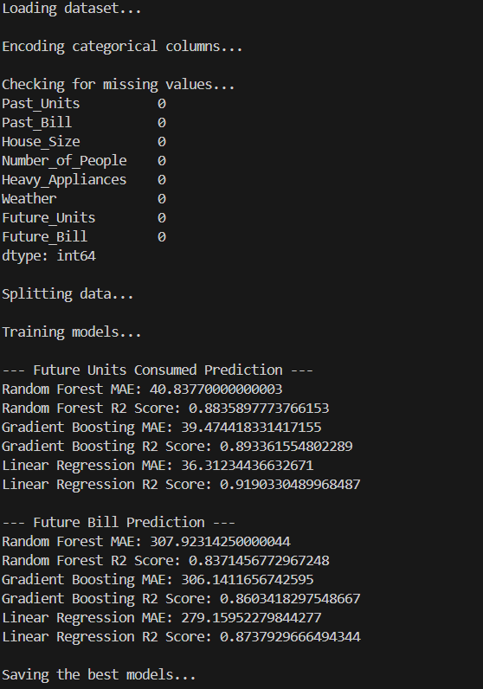
Implementation & Results of Module
Data Preprocessing
Clean & encode data, handle missing values
Result: Ready-to-use data for model training
Model Training
Models: RandomForest, GradientBoosting, LinearRegression
Result: Best models selected for predictions
Prediction & Recommendation
Predict future consumption & bills, generate energy
-saving tips
Result: Personalized recommendations for users
Efficiency Calculation
Calculate efficiency score (units per person)
Result: Show energy optimization targets

Slide 11
Conclusion & Future Work
Conclusion
Developed an intelligent energy consumption predictor using machine learning.
Integrated user-friendly web interface for input and personalized recommendations.
Achieved accurate predictions for future units and electricity bills.
Enhanced awareness about energy efficiency through actionable tips.
Future Work
Integrate real-time data from smart meters or IoT devices.
Include additional features like appliance-level consumption analysis.
Expand to renewable energy suggestions and carbon footprint tracking.
Deploy the system on cloud for large-scale accessibility and scalability.

Slide 12
References
[1] Box, G. E., Jenkins, G. M., & Reinsel, G. C. (2008). Time Series Analysis: Forecasting and Control.
[2] Hong, T., Wilson, J., & Xie, J. (2010). Long-term probabilistic load forecasting and normalization with hourly information.
[3] Fan, S., & Hyndman, R. J. (2012). Short-term load forecasting based on a semi-parametric additive model
[4] Ahmad, T., Chen, H., Guo, Y., & Wang, J. (2018). A review on renewable energy and electricity requirement forecasting models for smart grid and buildings.
[5] Kuster, C., Gallachóir, B. P. Ó., & Kinnane, O. (2017). Residential energy demand modeling using appliance-level data.
[6] Debnath, K., et al. (2019). Non-intrusive load monitoring using smart meter data: A deep learning approach.
[7] Kavousian, A., Rajagopal, R., & Fischer, M. (2013). Determinants of residential electricity consumption: Using smart meter data.
[8] Tariq, M., et al. (2020). Impact of weather conditions on energy consumption in residential buildings using machine learning.

Slide 13
Paper Publication Status
Not Published

Slide 14
Thank You

